Slide 1

Whitebox and Blackbox Testing
This and pen testing are the ones we use the most

Slide 2

Major Security Testing
Penetration Testing – see board (let’s review physical & TryHackMe)
Box Testing, 2 types:
WhiteBox & BlackBox

Slide 3

White box testing
a type of software testing that tests the source code and the internal structure of a program rather than its functionality.
It focuses on the inner workings of the code to ensure that all the internal components work as expected and are error-free.
Testers have varying access to the code
full access to the part they are testing is typical but may not have full access to all code
Testers may also have access to design documentation, briefings, and other artifacts from engineering groups
It is also known as clear box testing, glass box testing, code-assisted testing, or structural testing.

Slide 4

Black box testing
a type of software testing that tests the functionality of the system over any internal issues.
It focuses on the ability of the project to meet expectations of the client without errors or issues.
Testers have no access to the code.
Still may have access to design artifacts but typically these are just wireframes or other diagrams over engineering ones.
It is also known as functional testing or behavioral testing.

Slide 5
Blackbox is simpler
Let’s start with a real-world example of that – my son performing this type of testing

Slide 6
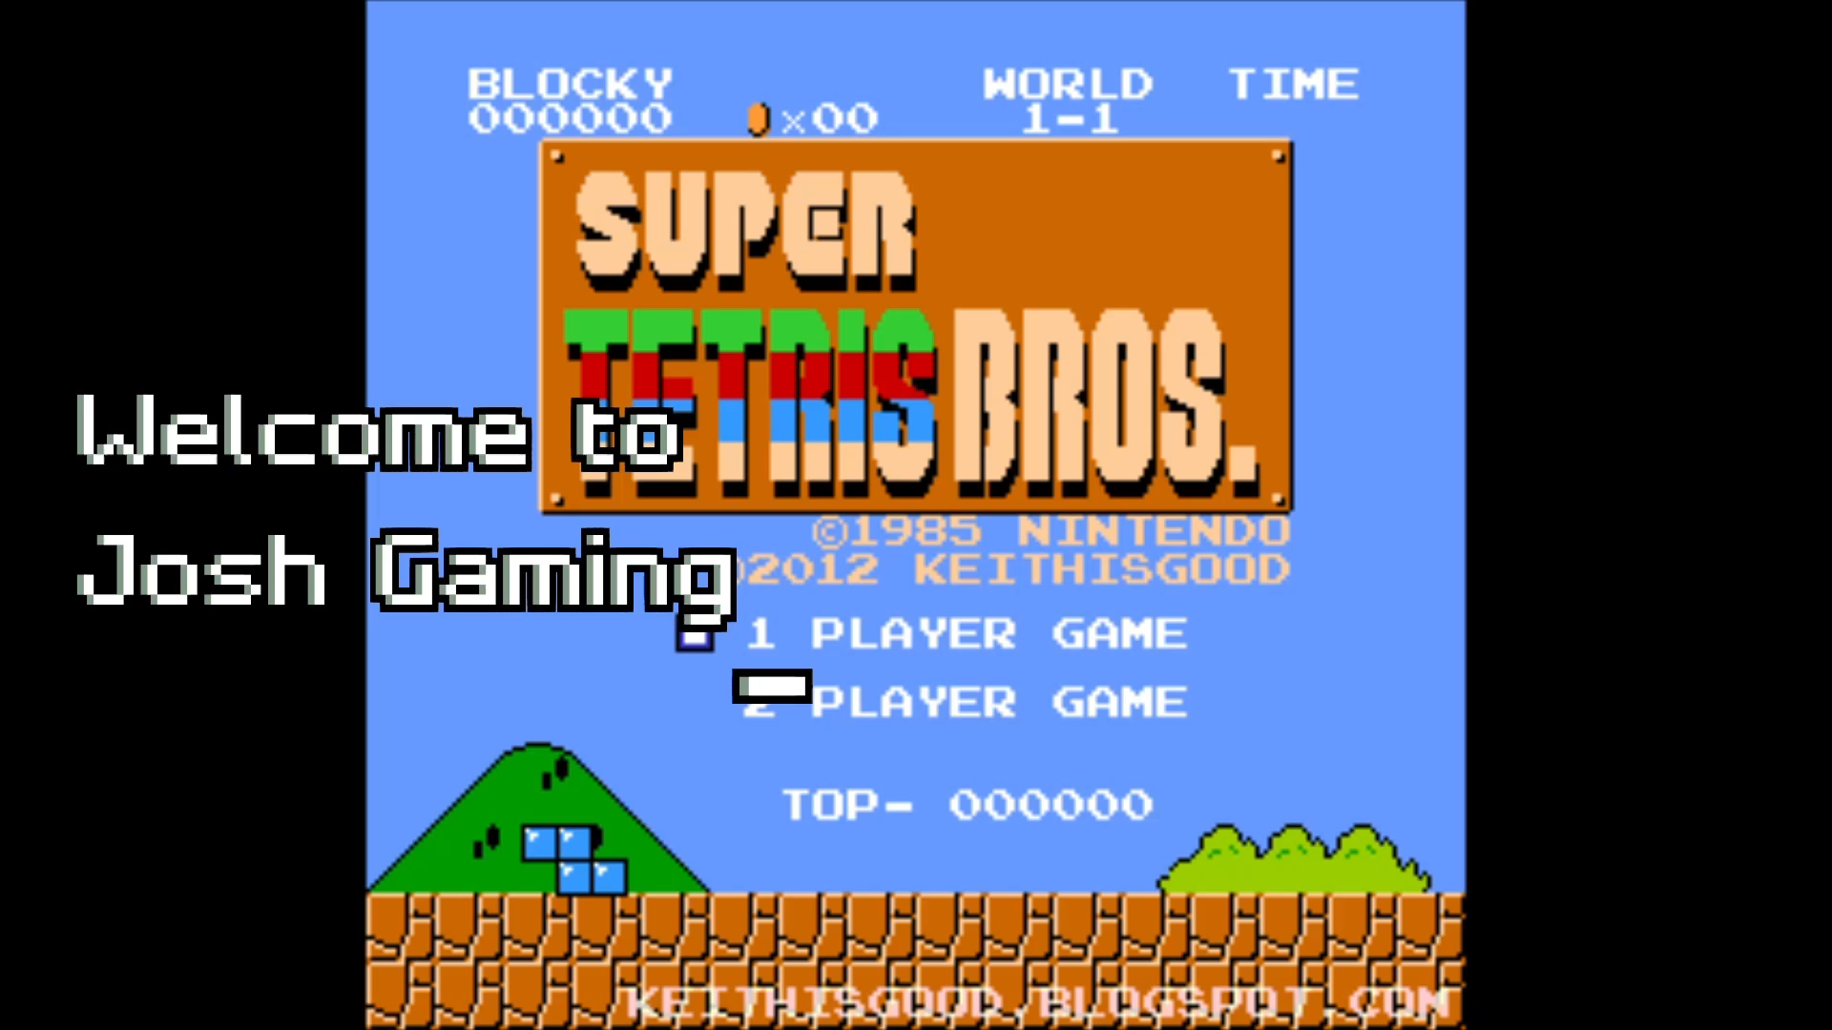
My Son blackboxes my games: He cannot see the code
What group
is this
great for?

Slide 7
Blackbox is most used with
Acceptance Testing
Alpha/Bravo with feedback
Non-IT personnel
Intern has nothing to do? Try to break this and report any breaks!
IT Manager wants to help?
Seriously have used this and it wasn’t even a non-technical IT manager
QA testers
When you have those groups
Bug Reporting Contests!
See your reading – it’s a thing

Slide 8
Only non-technical? Where does it fit with pen-testing?
Its not pen-testing because the focus is different, and knowledge makes it different
You would look for breaks in software that you can exploit (over functionality)
It can be one of the initial set of tests you run (cause if these are broken its bad and can point to easy exploits)
Passive or Active?
Its still active
What tools?
The UI basically:
All blind SQL Injection Tests
All false tests using browser
Trying different emails for a company with variances of “password” from browser
Trying to break a search and get back code
Your own GUI (including Console)
Enter your choice 1-5: (you enter “ls –l”)
Trying to open the wrong file with just string input
Try clicking on the wrong buttons or move into area you shouldn’t be able to access

Slide 9
Let’s try it with a bit of code
Yes you can technically see the code – but try to just download it and run it instead
Open in IDLE if on Desktop
You may have to install it using Apps Anywhere
Without looking at code – find breaks with group
How many you find?
How does it break functionality?
Are any indicators of exploitable issues?

Slide 10

Whitebox
Now we get the code

Slide 11

White box looks for
Ensure
Ensure every independent path in a module is tested at least once
Logical
Find Logical or design errors that can occur during actual implementation
Security
Find any security gaps or vulnerabilities in the code
Identify
Identify broken or inefficient paths and redundant conditional logic
Check
Check typographical errors and syntax

Slide 12
Whitebox is usually automated (its huge advantage is its one of the easiest to automate)
At least at some level, GitHub adds actions with code checking and dependency checking
If you want to check each link is still working:
How would you do that manually?
How might you do that automatically?
What do you use on your IDEs which automatically performs the first part of Whitebox Testing?
Linter – feeds → IDE’s intellSense (code, etc.).
This means it starts the minute you start writing code
This is part of Continuous Integration and Continuous Development Principles of DevOps (…or DevSecOps)

Slide 13

Basic Steps
Preparation and input: Who will do it and what part will they do?
For white box testing, a tester must be well acquainted with the programming language to understand the code being tested better.
This varies by task but as Chief I was expected to deal with some level of Python testing because I was one of the few who dealt with the internal C to help Extend it
Also acquainted with project so then understand the functional specifications, design, security specifications, types of requirements, and the source code style/structure.
Create and execute tests: multiple testers create these tests based on focus
the tester will now create tests for all the possible scenarios that the program is designed to handle and run them
Do not have to be code tests but will include code tests
These can be use-case based, vulnerability focused, or based on a specific functionality
Output: Everyone adds to the report
After running the tests, the tester prepares a detailed final report that includes all the above testing preparations and test results.

Slide 14
We are going to semi-skip that as you wouldn’t be the testers
But you may be picked for a code review and it includes much of this and may have “tests” such as (2 of these are review Software/OS issues):
JSON file is required for storing state of game based on player/party states and where they are within world/plot. Ensure JSON created correctly, handled correctly (no memory leak), access controls are correct, and limit race conditions.
User should be able to enter “plain text” responses and the system respond correctly. This can include a default response for “I don’t know” statements and was added to ensure limitations on input. Ensure this is implemented and that its input sanitation is also correct.
Python has its own wrapper on file buffers (input/output in general) so ensure we are not mixing our streams with OS-level file descriptors. Ensure file Type is still being seen correctly by OS for altered binary files after creation and still work with custom buffering policy.

Slide 15
So open the code and take a bit finding some issues
You will need to use them in the discussion board
There are so many – try and categorize them

Slide 16

Thursday
Testing part 2

